Slide 1


IoT APPLICATION DEVELOPMENT
USING RASPBERRY Pi
Project based Industrial Training on Blockchain, IoT and Machine Learning using Python
CITK & NIELIT GHY

Slide 2
WHAT WE LEARN
Raspberry Pi Setup
Sensors like DHT-11, LED
Application Development
Cloud Setup
MQTT Protocol
Communication Raspberry Pi using Application

Slide 3
Schedule
Raspberry Pi
MQTT
Development
Rpi & Sensors
Application Setup
Description/Setups
Description about MQTT and Setup
Development of application & Mqtt
9:00 |  | 10:00 |  |  | 11:00 | 12:30 |  |  | 2:00
Sensor Setup
Application Setup/Environment setup

Slide 4

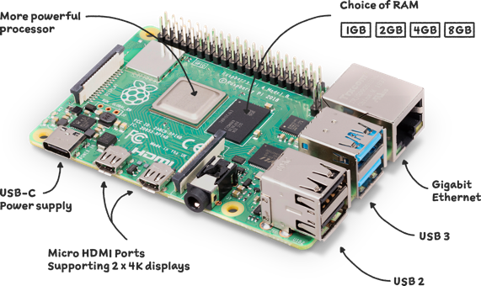
RASPBERRY PI
Computing for everybody
From industries large and small, to the kitchen table tinkerer, to the classroom coder, we make computing accessible and affordable for everybody.

Slide 5
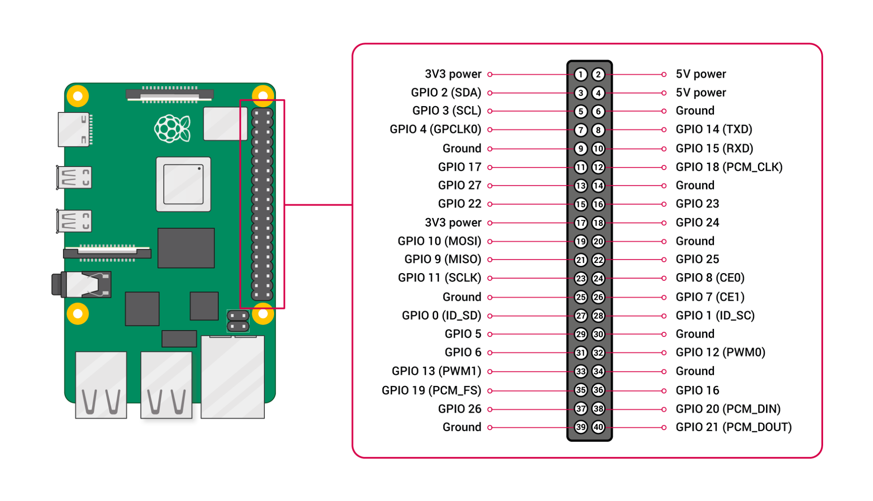
GPIO PINS

Slide 6
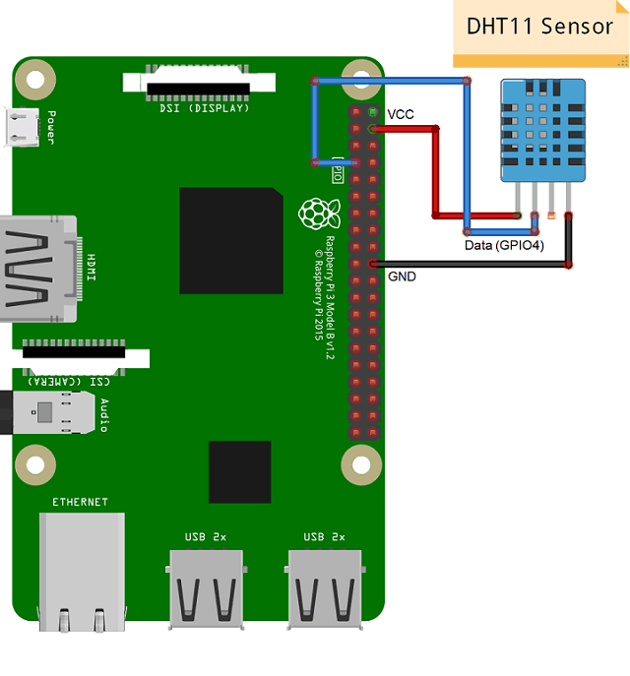
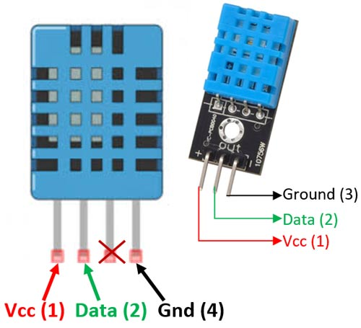
DHT-11

Slide 7
SETUP
sudo python setup.py install
pip3 install adafruit-circuitpython-dht

Slide 8
MQTT (MQTT is a lightweight IoT messaging protocol)
Installing the dependencies in RPi
Install python3
Install the MQTT client library
Use pip3 to Install
sudo apt install python3
git clone https://github.com/eclipse/paho.mqtt.python
cd paho.mqtt.python
python3 setup.py install
pip3 install paho-mqtt

Slide 9
MQTT COMMUNICATION
https://www.emqx.com/en/blog/use-mqtt-with-raspberry-pi
https://www.emqx.com/en/blog/use-mqtt-with-raspberry-pi

Slide 10
APPLICATION SETUP
IDE’s:
VS STUDIO CODE
ANDROID STUDIO
ENVIRONMENT SETUP:
DOWNLOAD JAVA (https://www.java.com/en/)
SET ENVIRONMENT ON YOUR PC
Advance
Environment
Path

Slide 11
THE END

